Slide 1



Twinning & Partnership Building
From Introversion... to Euroversion
Durmish Guri - CEMR's Director of Projects and Programmes
Empowering Local and Regional Europe since 1951

Slide 2
The Council of European Municipalities and Regions (CEMR)
Since 1951, CEMR is Europe's first and broadest association of Local and Regional Governments, representing:
SOCIETY
60
110K
Local and Regional Governments
Member Associations
CLIMATE
41
1M
Elected Representatives
Countries
LABOUR
CEMR’s activities:
Advocacy and Policy
Projects and Programmes
Knowledge
COHESION

Slide 3
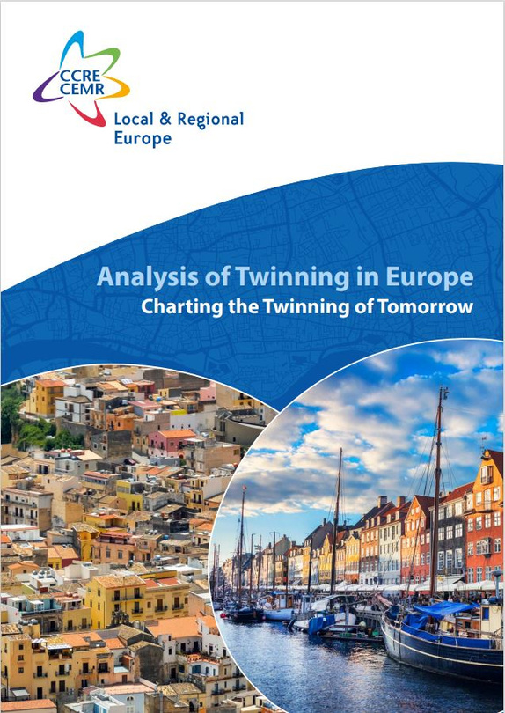
Definition
TWINNING
Historically, Twinning is a formal agreement, unlimited in time, between two sub-national governments who commit to developing joint activities involving their communities.
As a dynamic instrument for international cooperation, Twinning supports peer-to-peer exchanges, fostering connections across Europe and boosting mutual learning and joint problem-solving.
By strengthening solidarity and shared knowledge across borders, Twinning enhances the capacity of local governments to work together in addressing common issues, ultimately benefiting their citizens and communities.
More information:
Analysis of Twinning in Europe, CEMR, 2023

Slide 4

CEMR Twinning Pillars
By bringing together the Matchmaking Platform, Sub-grant mechanism, and Expert Group, CEMR strengthens its role as a key facilitator in Twinning and Partnership Building.
The Matching Tool
Sub-grant scheme
CEMR Expert Group
CEMR’s mission
Building on its strong legacy in Twinning and partnership-building, CEMR is
dedicated to fostering cooperation between territories of all sizes. It supports exchanges
across Europe, collects data, and drives strategic reflection on the future of Twinning—promoting
it as a key tool to strengthen democracy, improve local governance, and foster innovation.

Slide 5


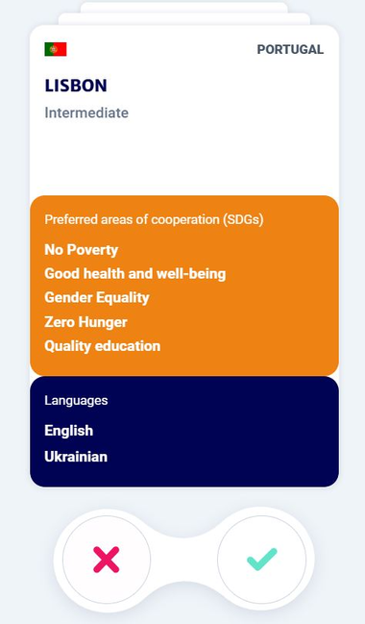
1. The Matching tool
The Matchmaking Platform is a digital tool designed to connect Local and Regional Governments across Europe. It facilitates Twinning and Partnerships Building by enabling municipalities and regions to find partners for collaboration and opportunities.
Which services does it provide?
  Partner matching
  Funding opportunities
  Best practices, guides, peer-to-peer learning
  More coming soon
Who can register?
Any local or regional authority in Europe.
COUNTRYTWIN
Citytwin
local
Preferred areas of cooperation (SDGs)
No Poverty
Good health and weel-being
Gender Equality
Zero Hunger
Quality education
Languages
More information:
Matchmaking Platform
Detailed information
It aligns with the core principles of
solidarity, mutual learning, and sustainable
development while maintaining the flexibility to
accommodate diverse cooperation models.

Slide 6
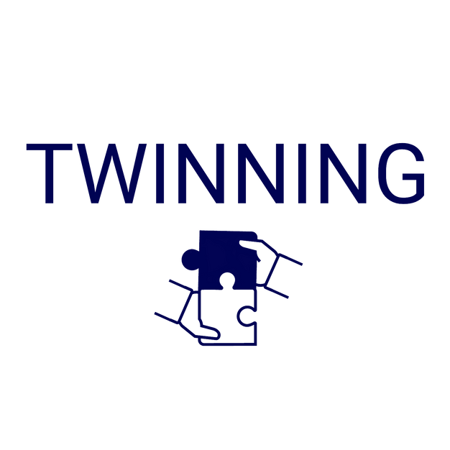
2. Granting Scheme
The grant scheme, co-funded by the European Commission, aims to foster Twinning, promote EU values, and address key thematic areas, including democracy, citizens participation, gender equality, and inclusion.
Each year, a portion of CEMR’s budget is allocated to strengthening Twinning initiatives via its member associations. Grants are awarded annually following a call for proposals open to CEMR's members.
More information:
REALISE 2024
Call for proposal for the sub-granting 2025

Slide 7
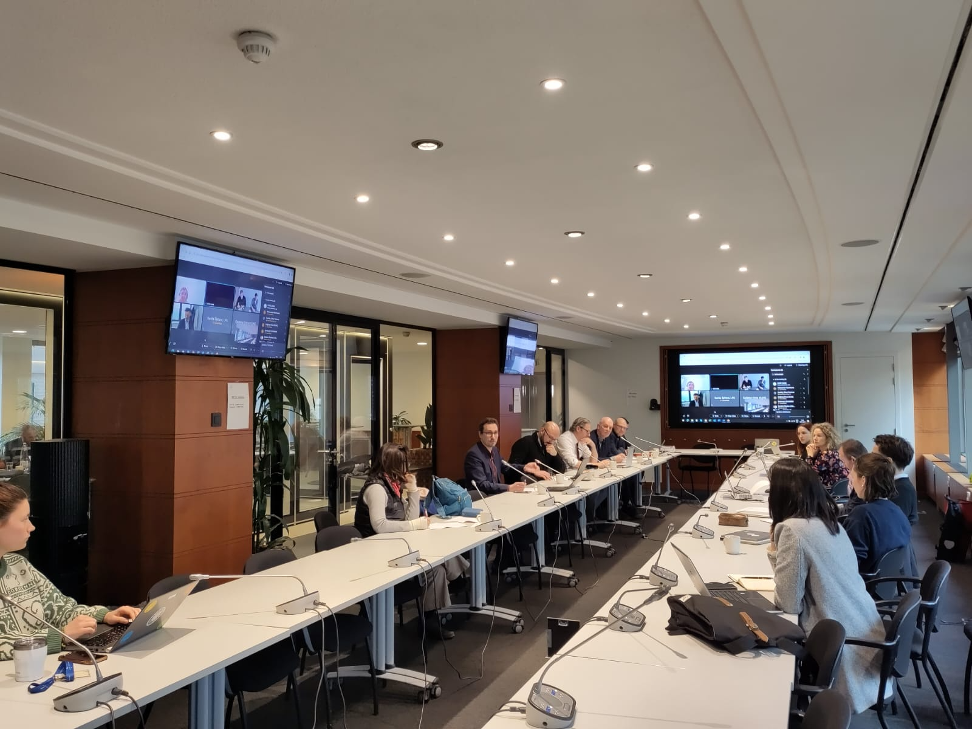
3. Expert Group
CEMR’s Expert Group on Twinning composed of member associations plays a crucial role in supporting the development and implementation of Twinning initiatives across Europe.
The group provides strategic guidance, shares best practices, and contributes to strengthening local governance and fostering international cooperation.

Slide 8
CEMR and members' joint work
  To foster connections and reinvigorate Twinning across Europe,
  Support Local and Regional Governements,
  Provide the tools and resources to boost impactful partnerships.
MEMBERS’ ROLE
  Be the national contact point, i.e. the key reference for Twinning and Partnershis Building, establishing a leadership role within their country and networks.
  Share best practices, contributing with valuable examples of successful initiatives from their territories, enriching the broader network with proven strategies and solutions to inspire and guide local and regional governements and other members.
  Advocating and communicating about Twinning, raising awarness and lobbying for its importance.

Slide 9





Thank you!
@CCRECEMR
@The Council of European Municipalities and Regions (CEMR)
Contact info:
twinning@ccre-cemr.org
durmish.guri@ccre-cemr.org
@ccrecemr
@cemrccre
https://ccre-cemr.org/

